Slide 1
Confederate Commemoration at VCU

Slide 2
The Virginia General Assembly created Virginia Commonwealth University in 1968 with the merger of the Medical College of Virginia (MCV) and the Richmond Professional Institute (RPI).
MCV traces its origin back to the Medical Department of Hampden-Sydney College which opened in November of 1838.

Slide 3
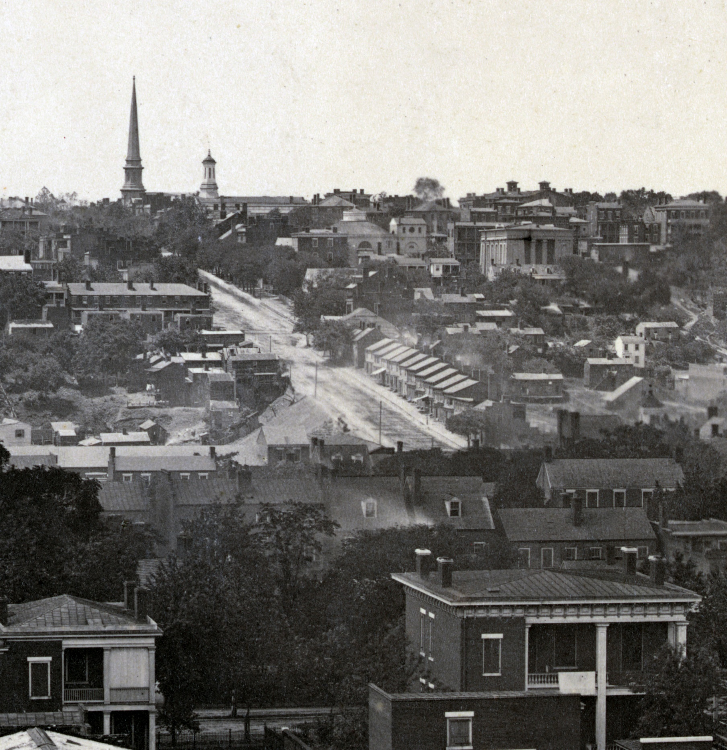
Richmond—April 1865
MCV remained open during the American Civil War. Its location in Richmond just blocks from the confederate capitol and government offices gave the medical school the unique opportunity to educate physicians and care for sick and wounded soldiers during the war.

Slide 4
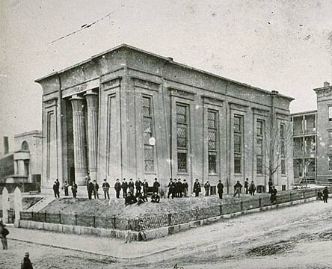
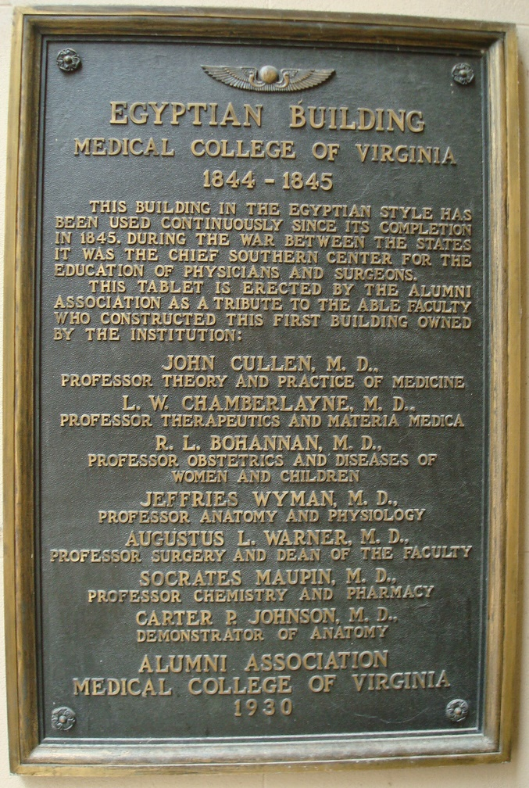
In 1930, the MCV Alumni Association honored the faculty who “constructed” the first permanent college building and acknowledged the role of the school during the Civil War.
Plaque outside west entrance of the Egyptian Building

Slide 5
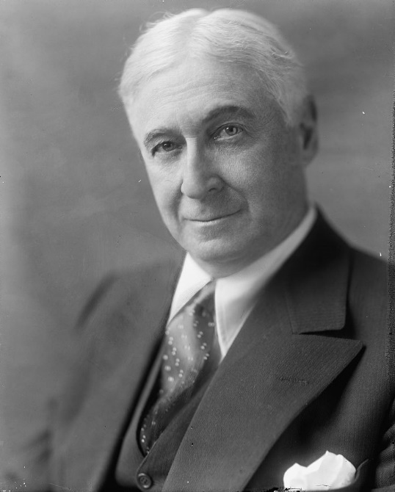
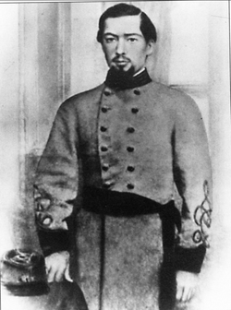
Philanthropist Bernard Baruch donated funds for the renovation of the Egyptian Building in 1939 in honor of his father, Simon Baruch, an 1862 graduate and surgeon in the Confederate Army
https://commons.wikimedia.org/wiki/File%3ABARUCH%2C_BERNARD_2.jpg

Slide 6
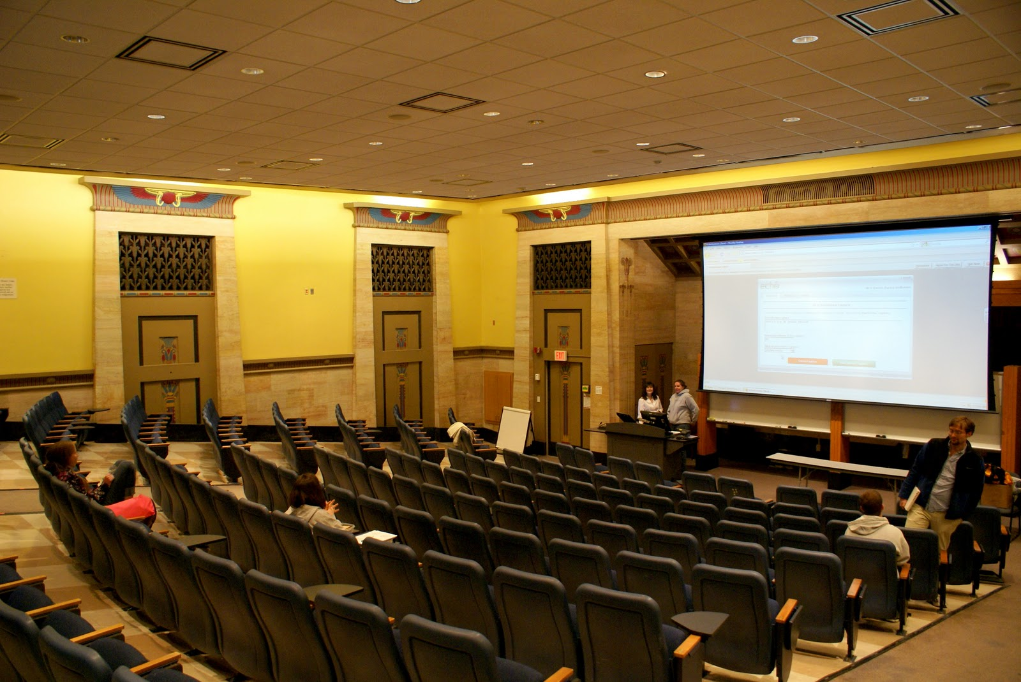
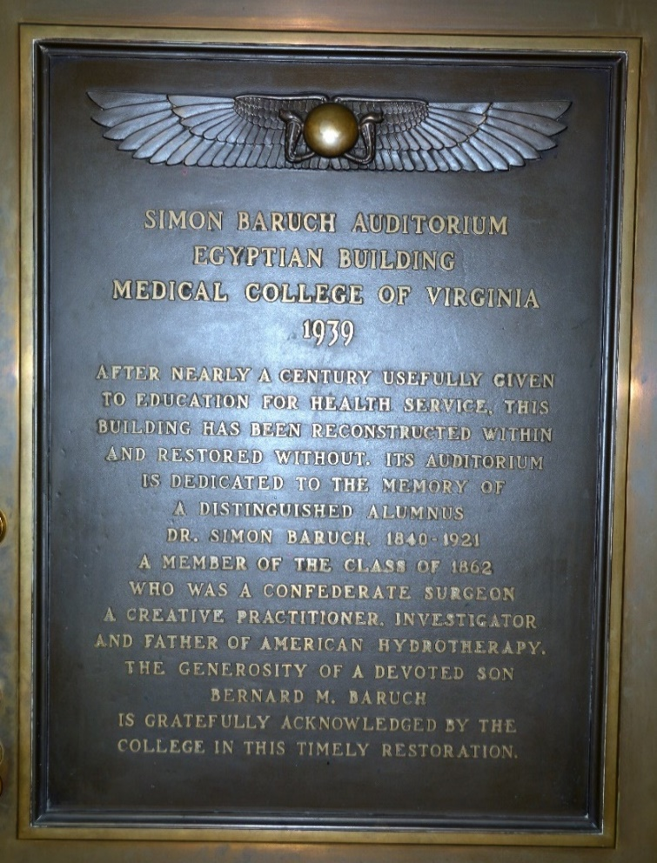
MCV named the auditorium inside the Egyptian Building in memory of Simon Baruch. A plaque outside the auditorium list Baruch’s accomplishments including his service in the Confederate Army.

Slide 7
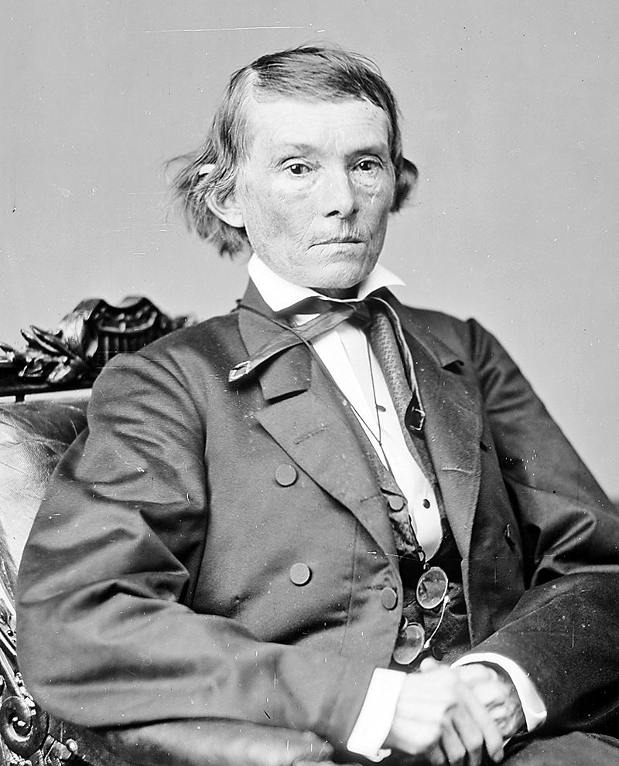
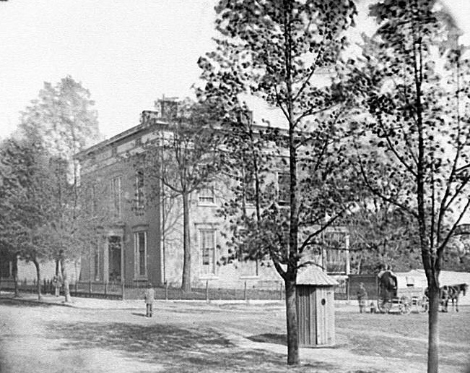
http://cdn.loc.gov/service/pnp/cwp/4a39000/4a39600/4a39614r.jpg
Public Domain, https://commons.wikimedia.org/w/index.php?curid=617531
Confederate Vice President Alexander Stephens lived in the Bruce-Lancaster House at the northwest corner of 12th and Clay Streets when he was in Richmond during the Civil War.

Slide 8
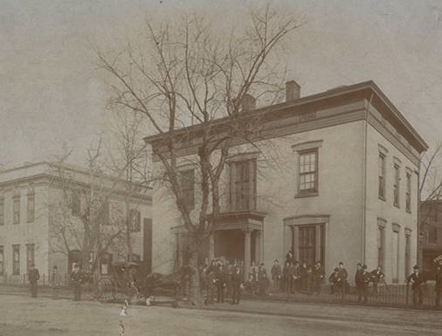
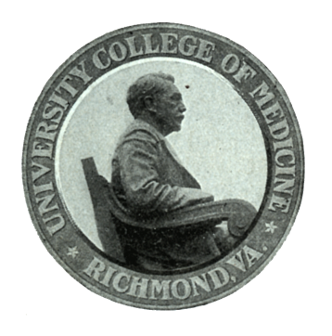
The University College of Medicine used the Bruce-Lancaster House as a classroom and administrative building from 1893 until January 1910 when it was destroyed by fire.

Slide 9
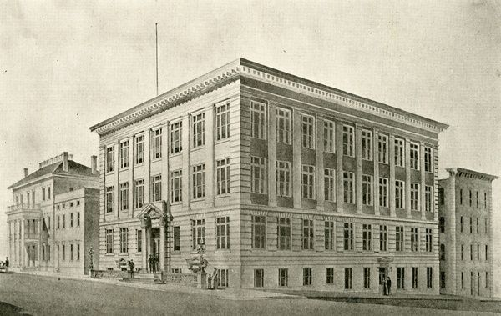
The citizens of Richmond contributed funds to construct a new building for the University College of Medicine which opened in May of 1912.

Slide 10
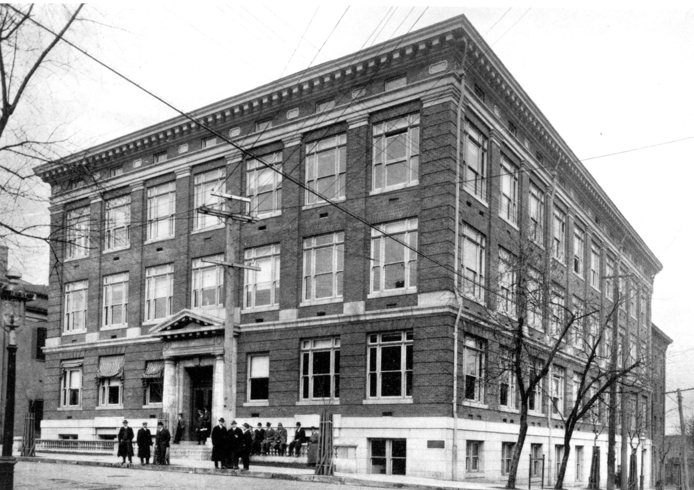
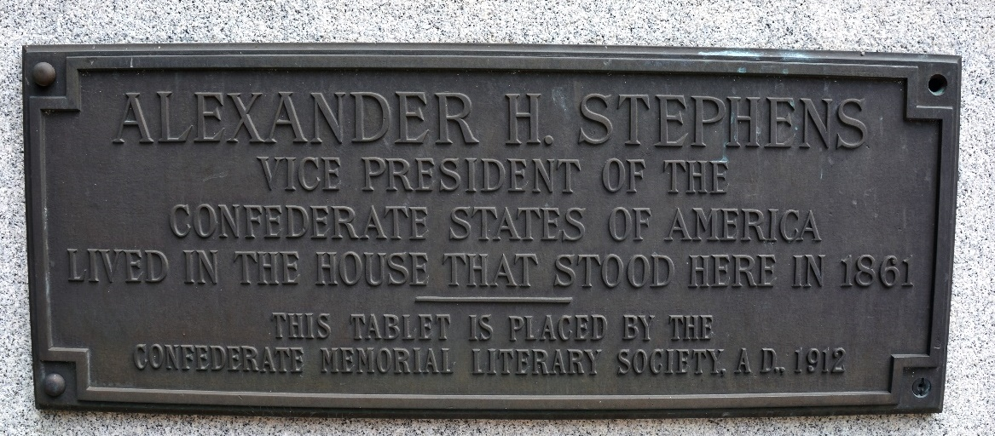
At the time of the building’s dedication, the Confederate Memorial Literary Society placed a plaque on the exterior of the building acknowledging the place where Stephens had lived in 1861.
Plaque on the southeast corner of the building

Slide 11
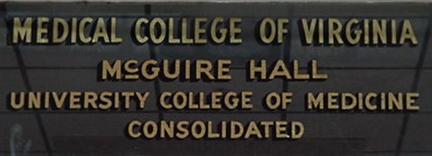
MCV and the University College of Medicine merged in 1913. MCV acquired the old UCM building.

Slide 12
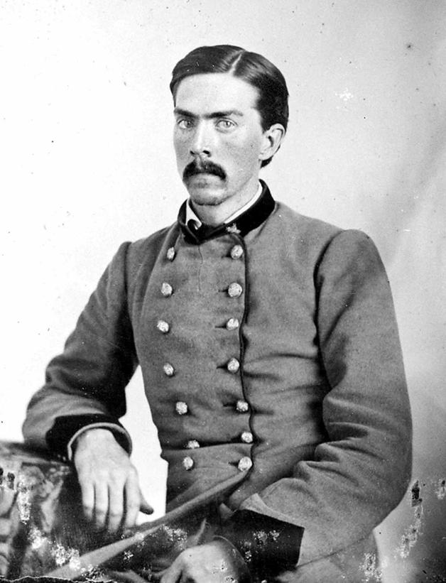
In December of 1927 the MCV Board of Visitors named the old UCM building “McGuire Hall” in honor of the school’s founder Hunter Holmes McGuire. He also served as professor of surgery at MCV and as the medical director of Confederate General “Stonewall” Jackson’s 2nd Corps.

Slide 13
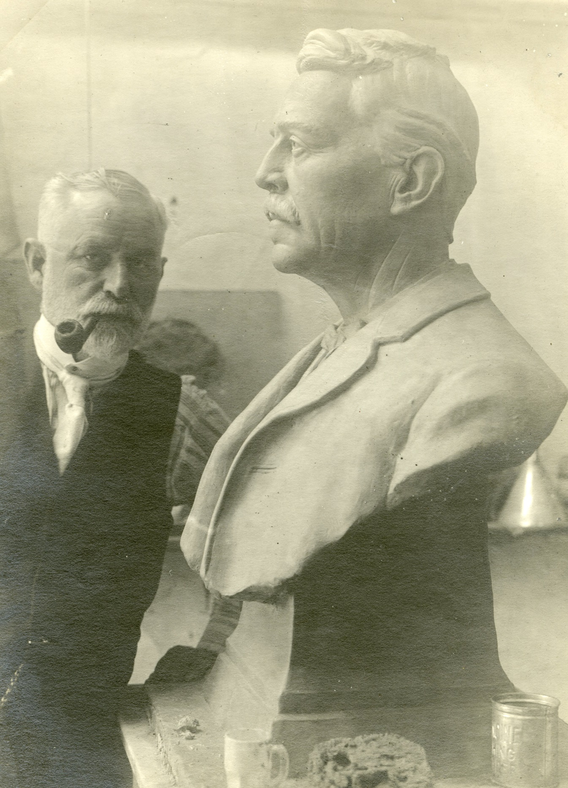
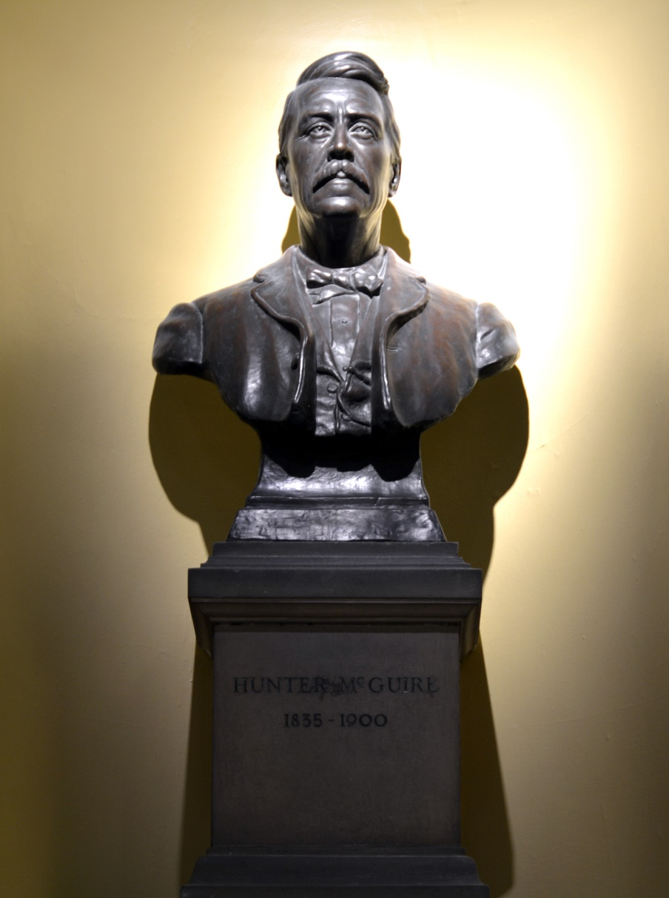
In McGuire Hall on the staircase landing between the first and the second floors is a bust of Hunter Holmes McGuire sculpted by MCV anatomy professor John W. Brodnax.

Slide 14
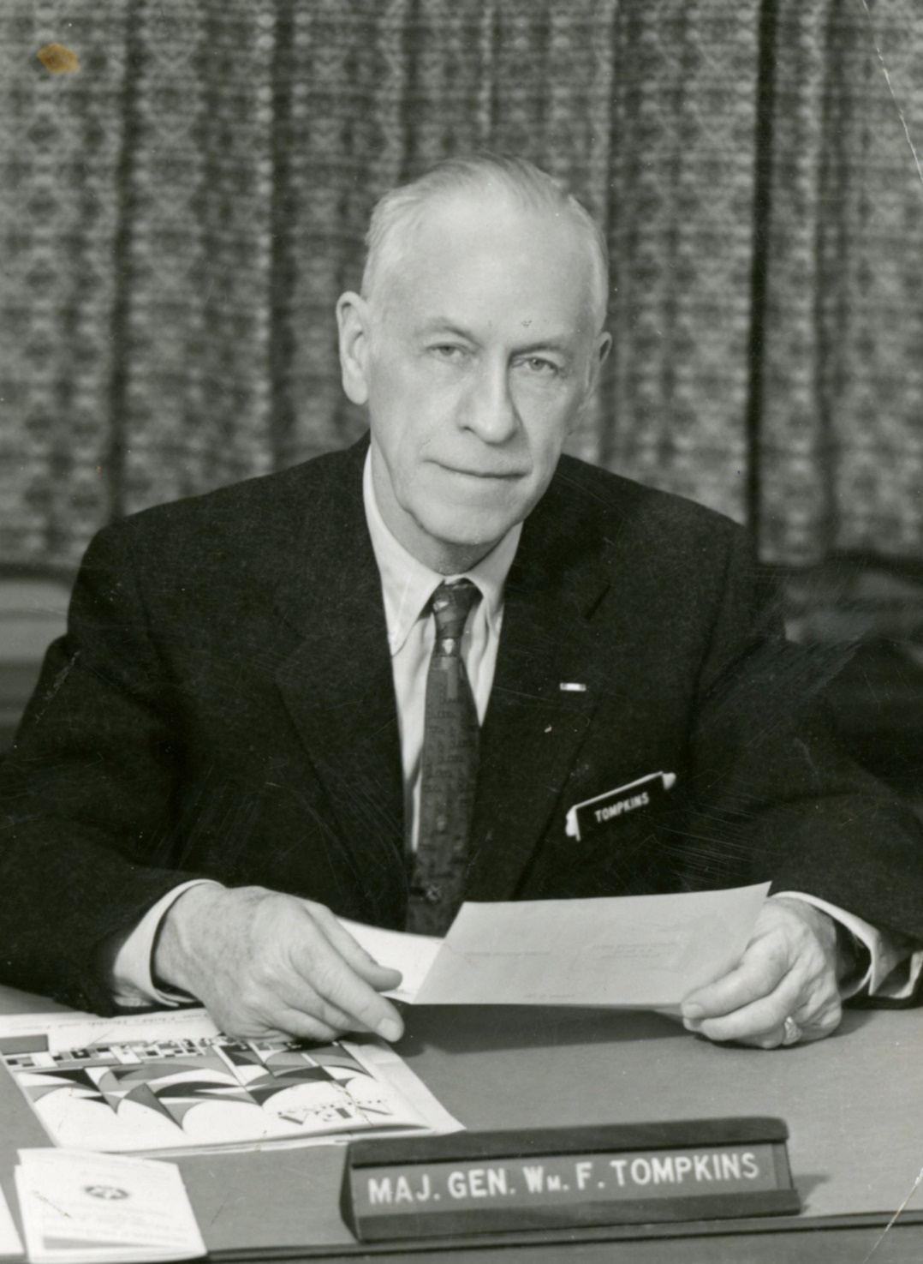
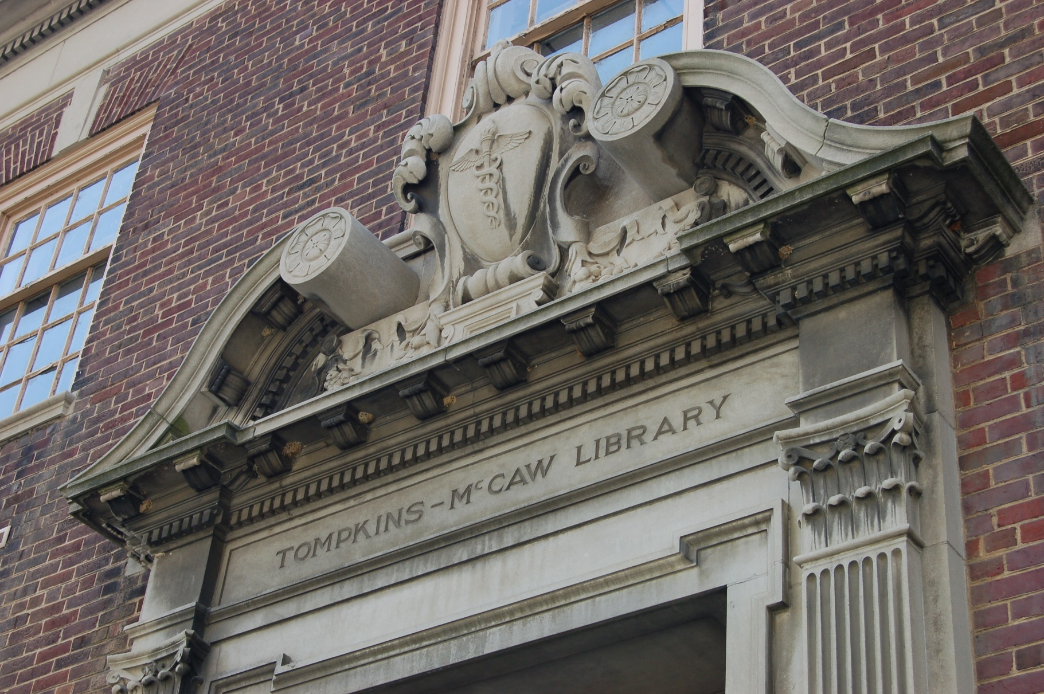
MCV Comptroller William F. Tompkins suggested the name Tompkins-McCaw for the college library.

Slide 15
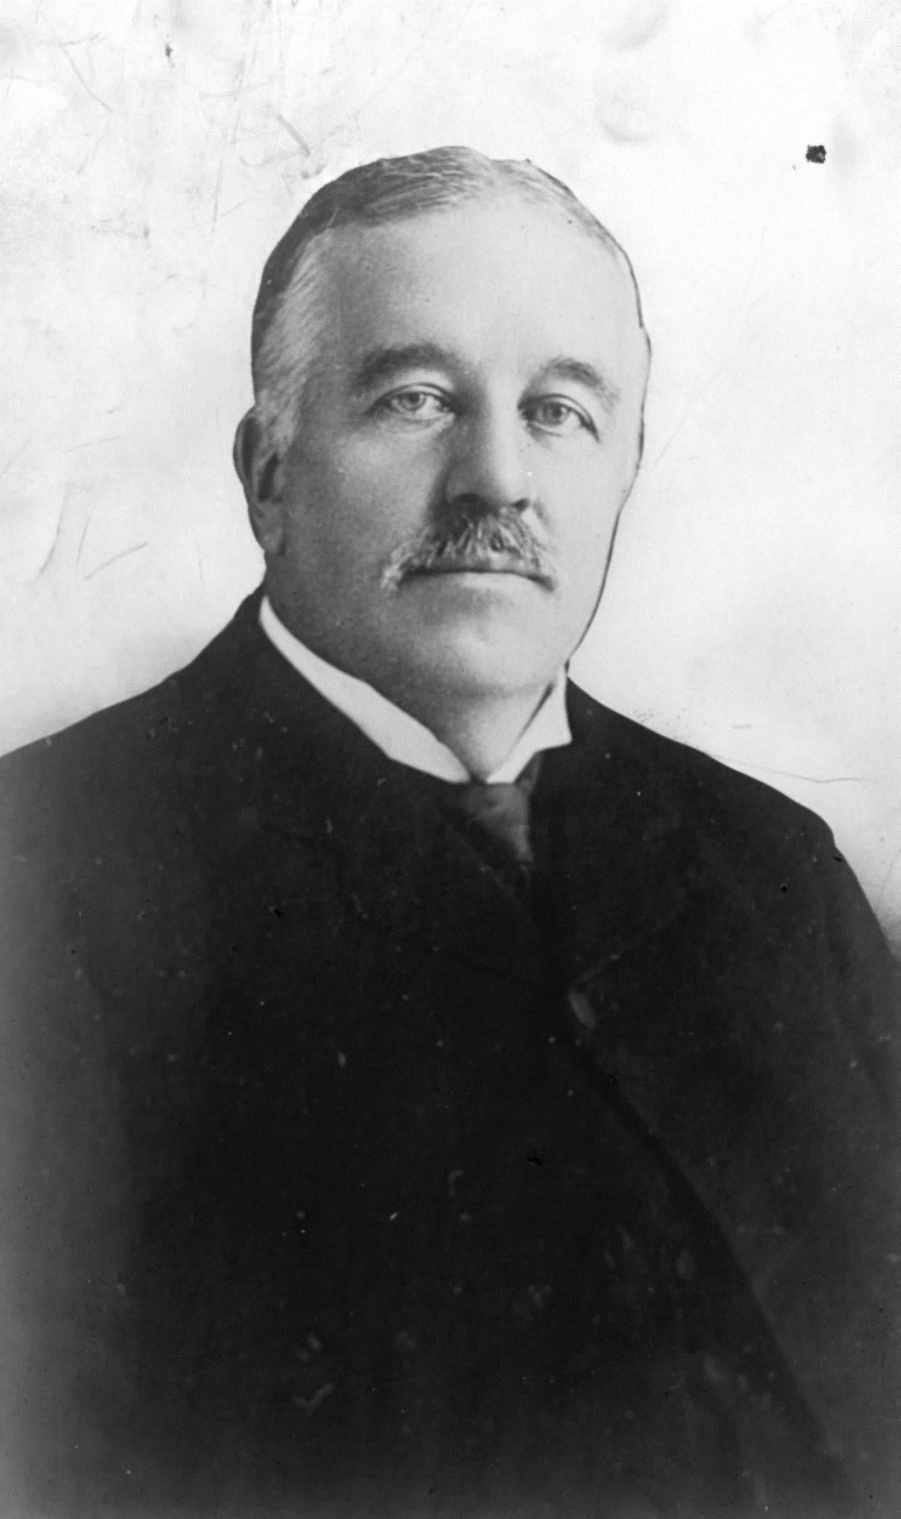
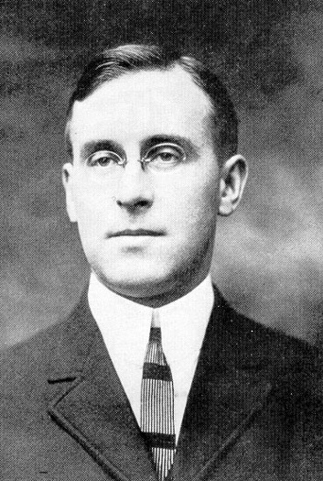
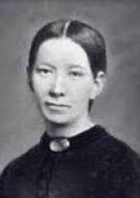
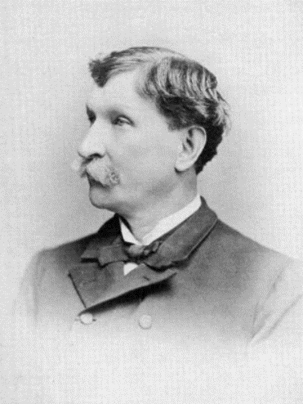
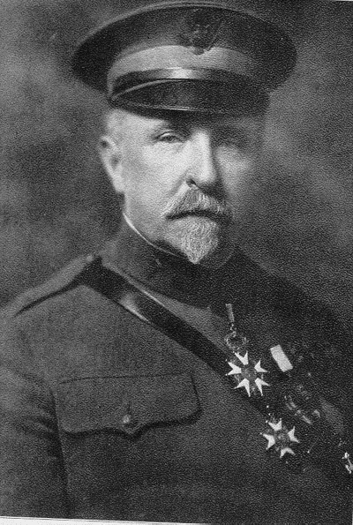
Christopher Tompkins
J. McCaw Tompkins
Sally Louisa Tompkins
James B. McCaw
Walter Drew McCaw
In March of 1950 the MCV Board of Visitors formally named the college library in honor of five individuals from the Tompkins and McCaw families.

Slide 16
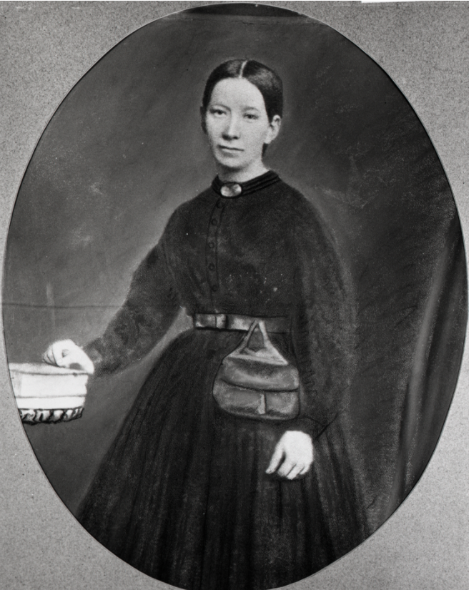
Sally Tompkins organized and administered the Robertson Hospital in Richmond during the Civil War.

Slide 17
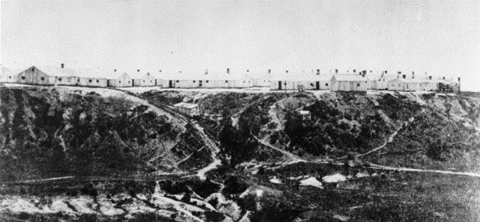
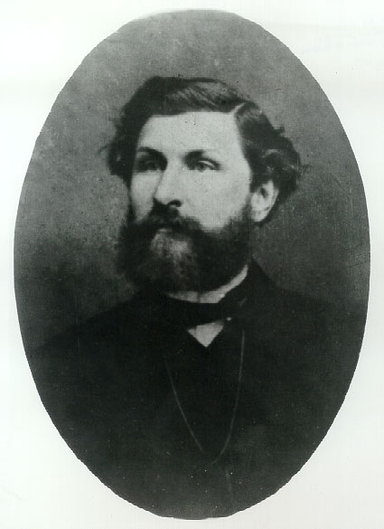
James McCaw served as commandant of the Chimborazo Confederate army hospital during the Civil War

Slide 18
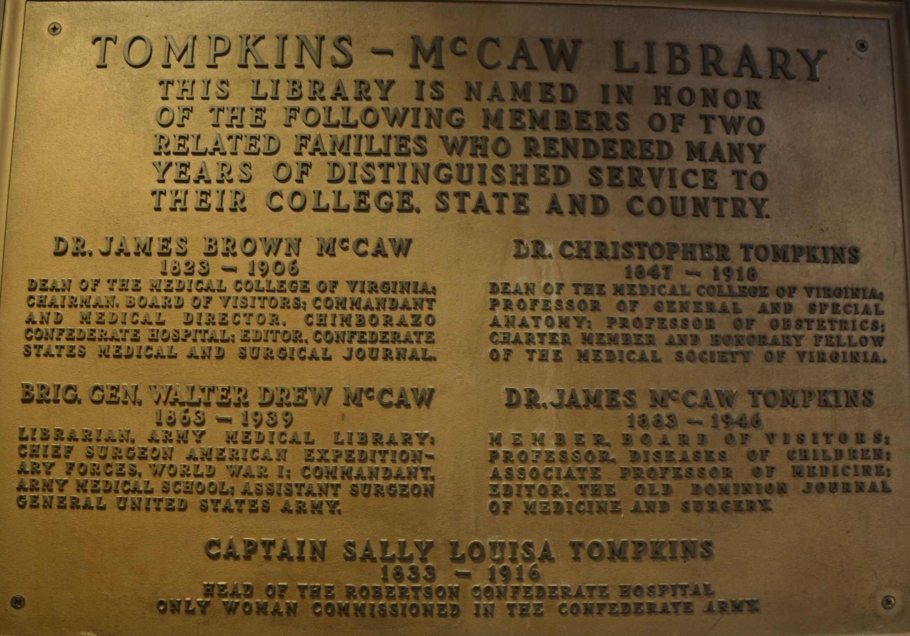
A plaque in the vestibule of the Tompkins-McCaw Library lists the building’s namesakes and their accomplishments.

Slide 19
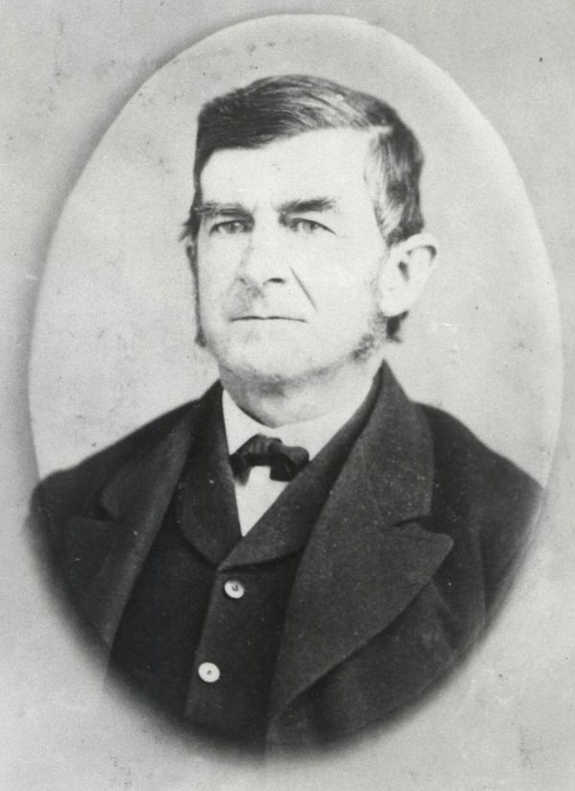
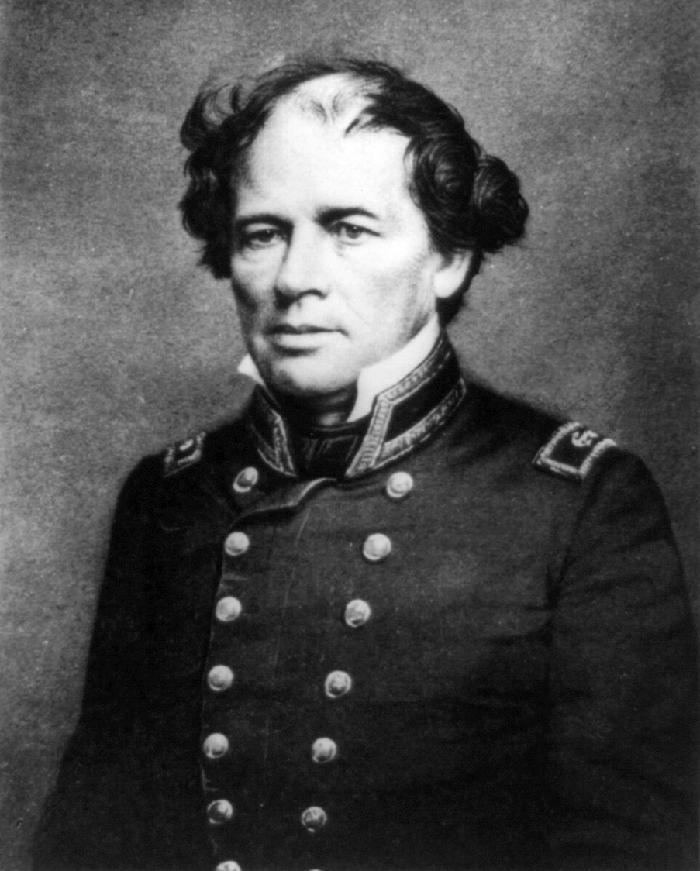
MCV founder Socrates Maupin (left) built a townhouse on Clay Street between 11th and 12th Streets. In this house, Commodore Matthew Fontaine Maury (right) conducted experiments with the underwater torpedo for the confederate government.
https://commons.wikimedia.org/wiki/File%3ALt._Matthew_Maury.jpg

Slide 20
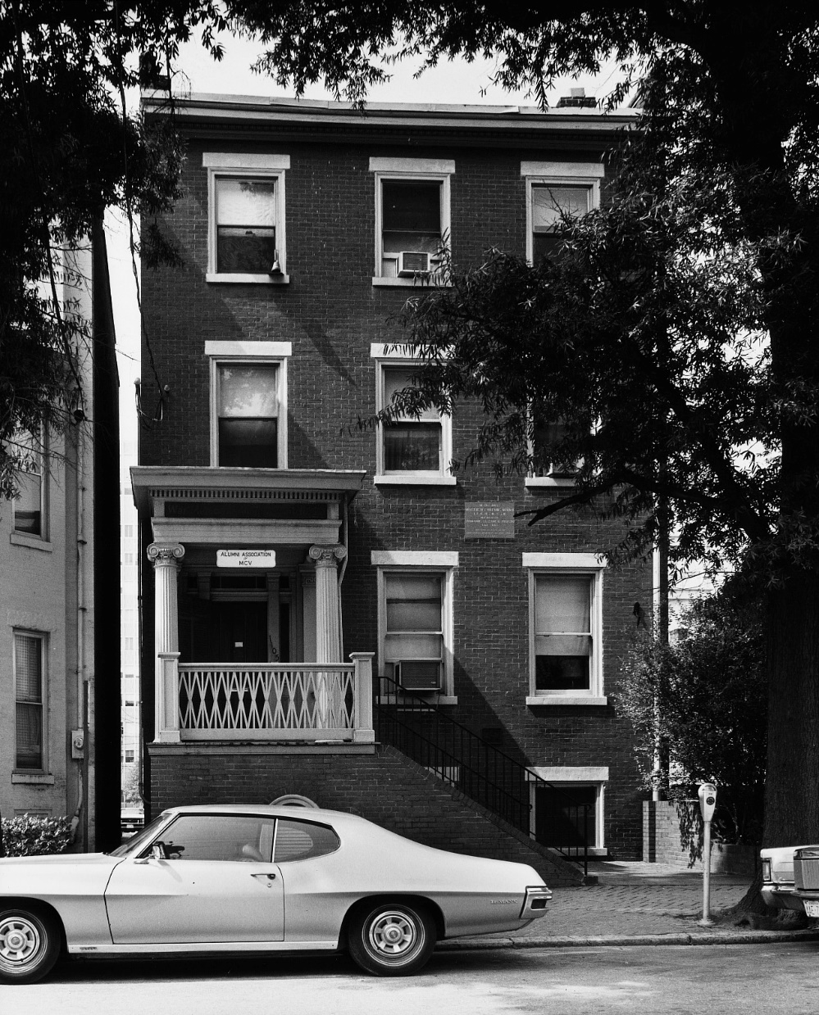
The MCV Alumni Association acquired the Maupin-Maury House in 1947 and secured landmark status for the house. The Confederate Memorial Literary Society placed a plaque on the house in 1910 noting Maury’s experiments.

Slide 21
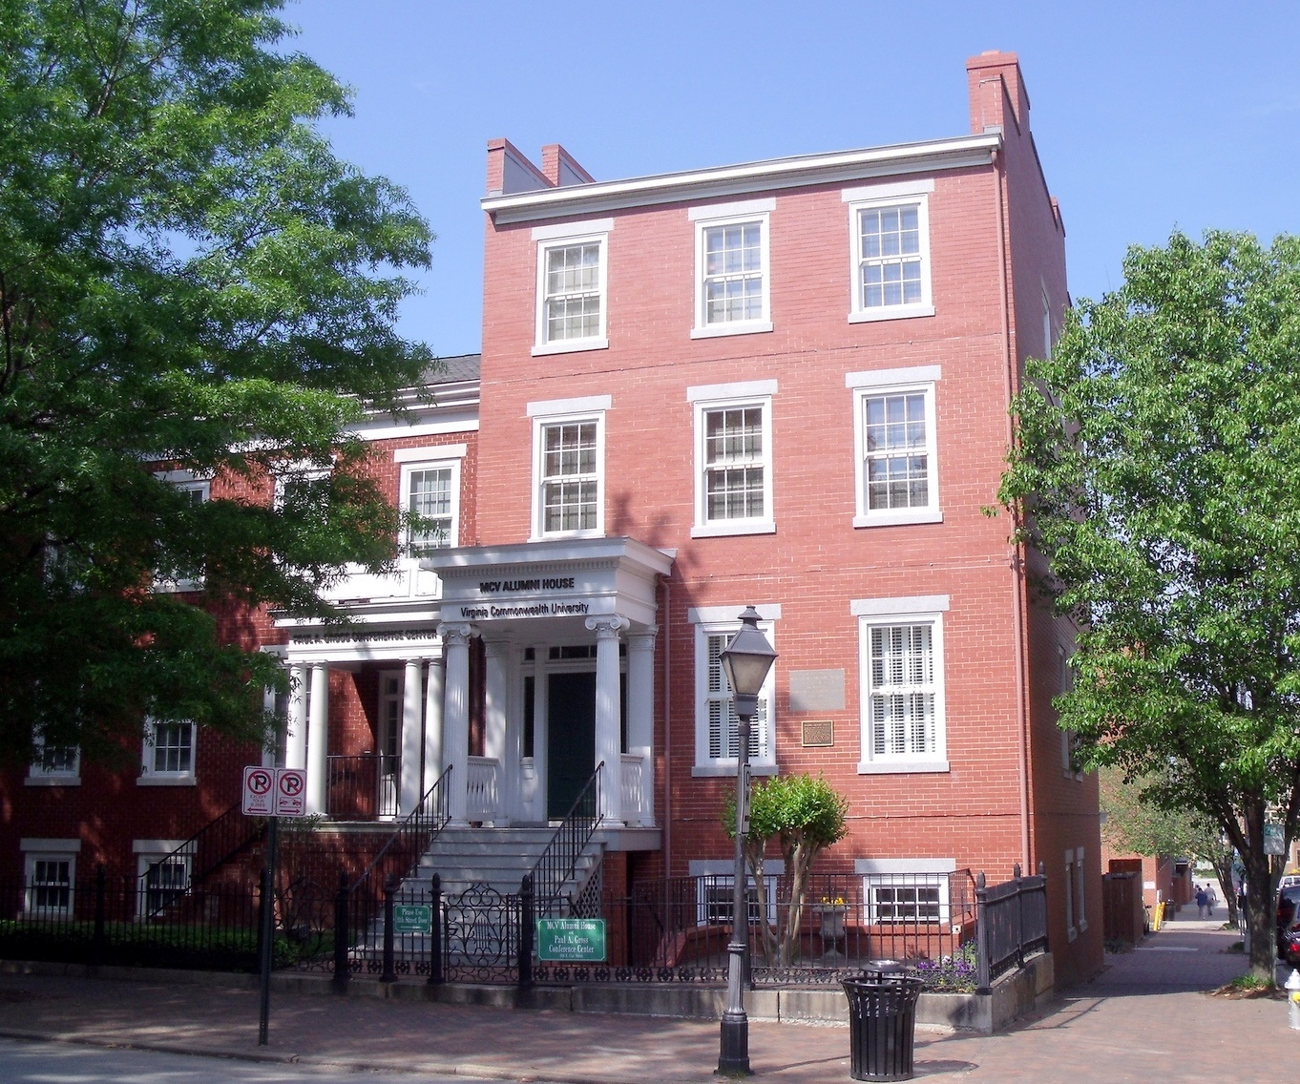
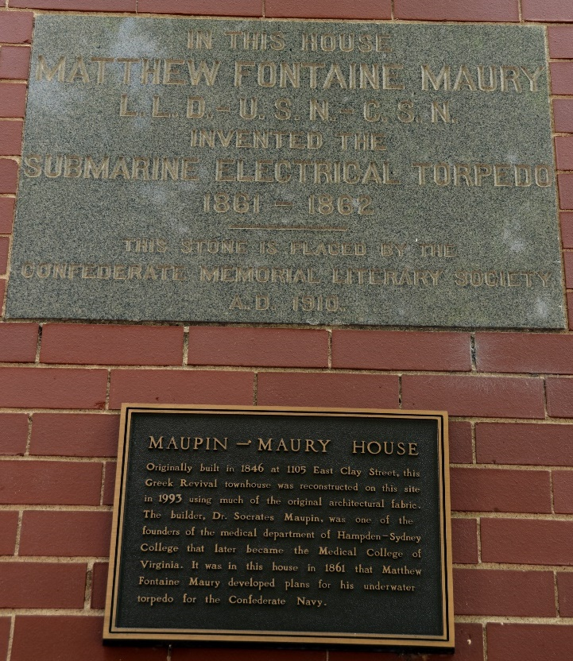
Today the MCV Alumni House and the Paul A. Gross Conference Center includes architectural features from the original Maupin- Maury House including these historical plaques.

Slide 22
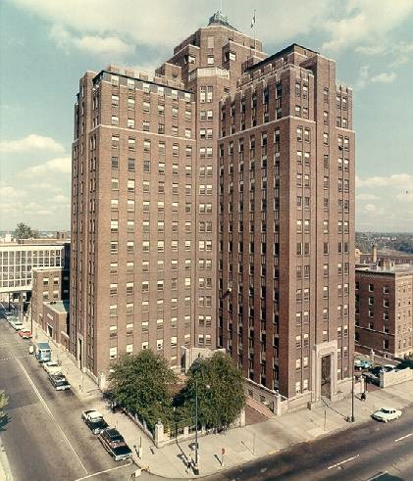
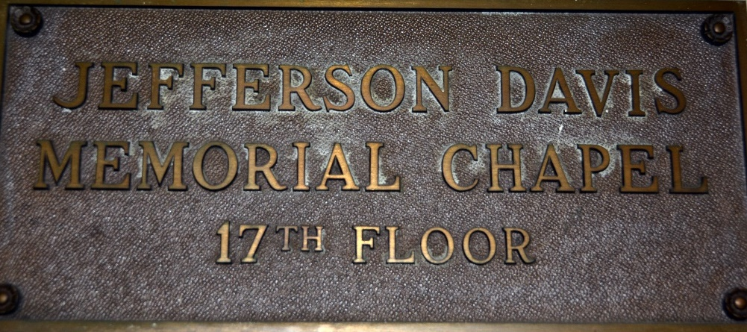
The United Daughters of the Confederacy donated about $30,000 to MCV to create a chapel as a tribute to confederate president Jefferson Davis for use by the MCV community.
Plaque in the lobby of West Hospital

Slide 23
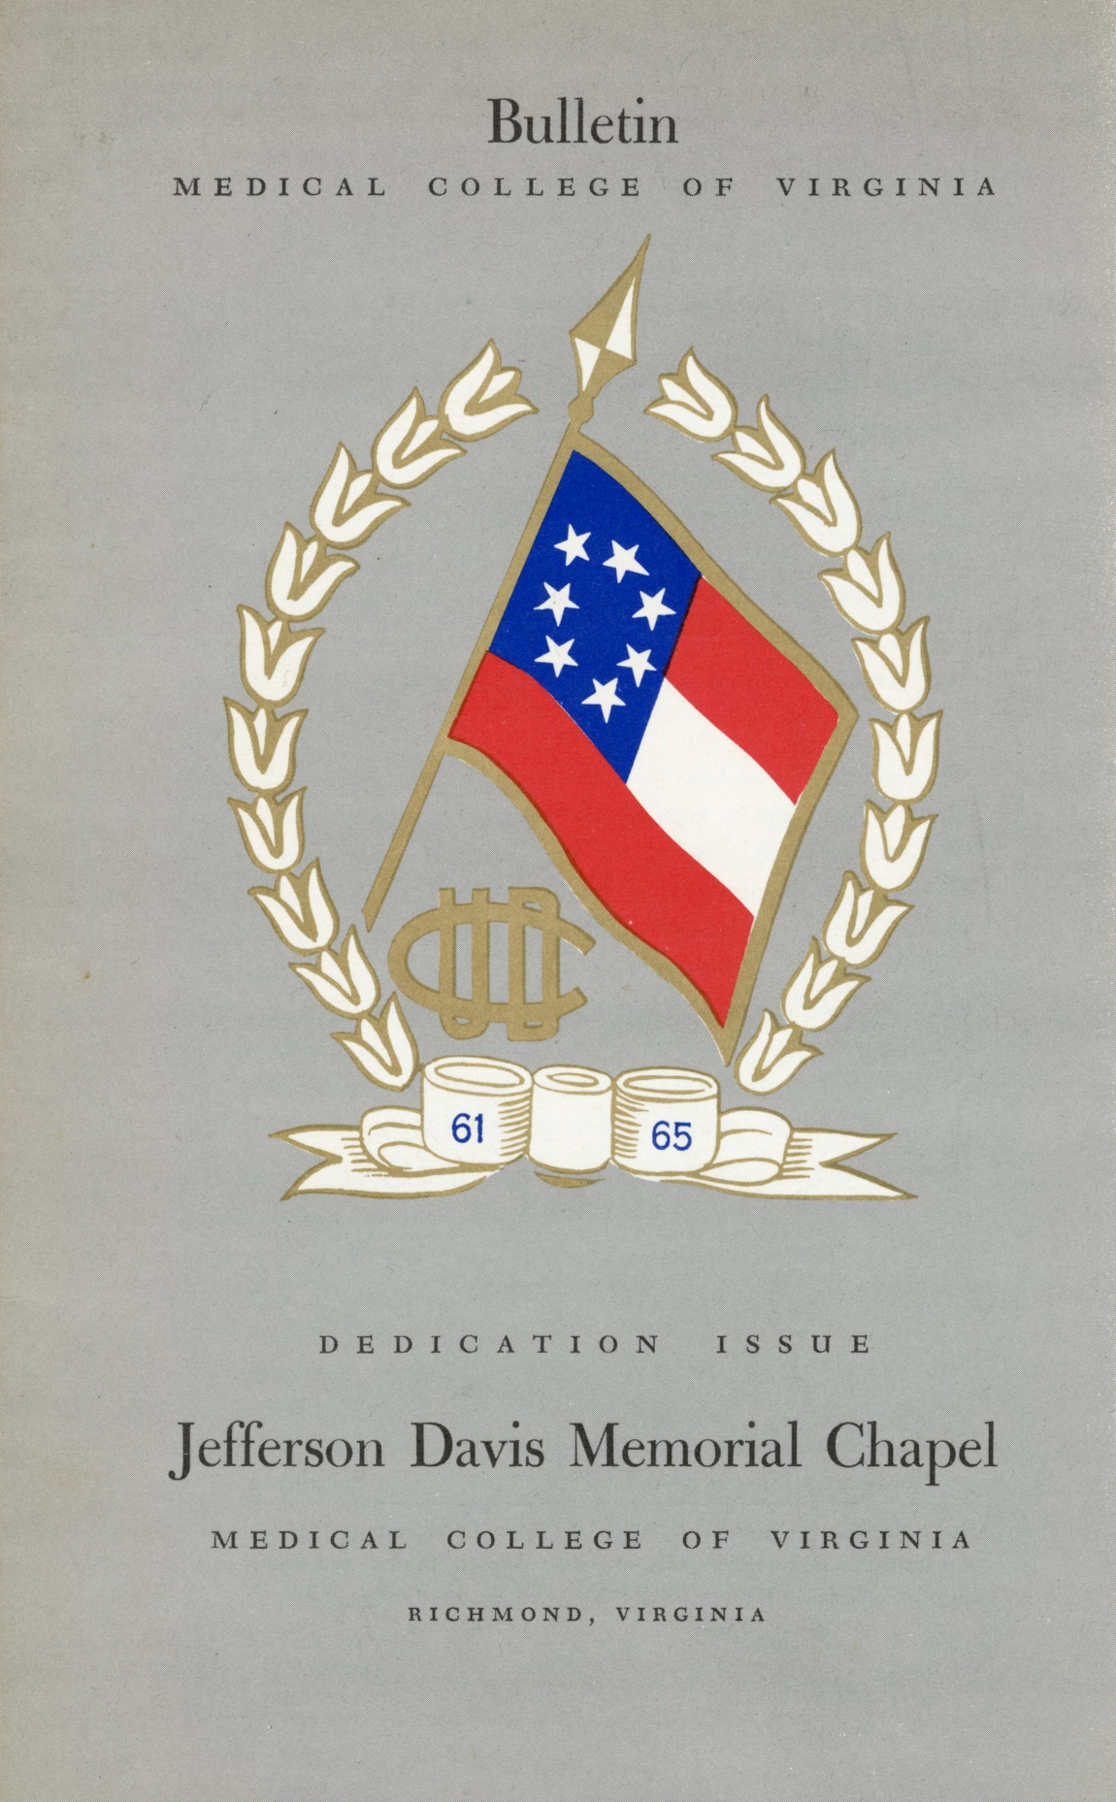
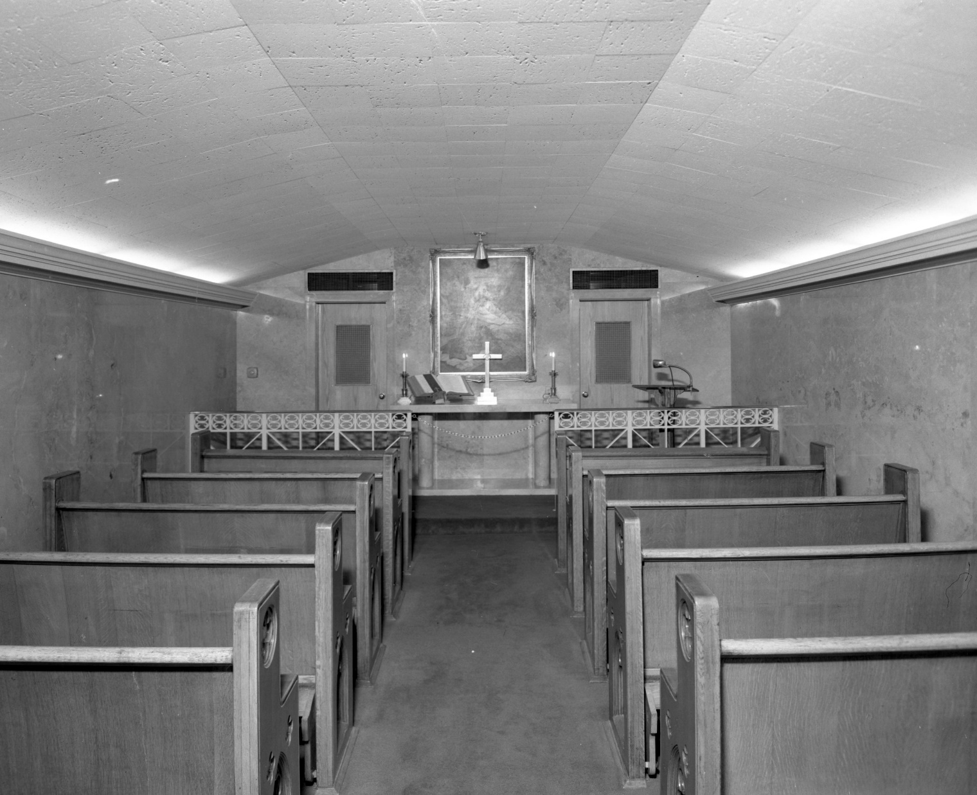
The Jefferson Davis Memorial Chapel on the 17th floor of the south wing of West Hospital, as it looked at its dedication on November 12, 1960.

Slide 24
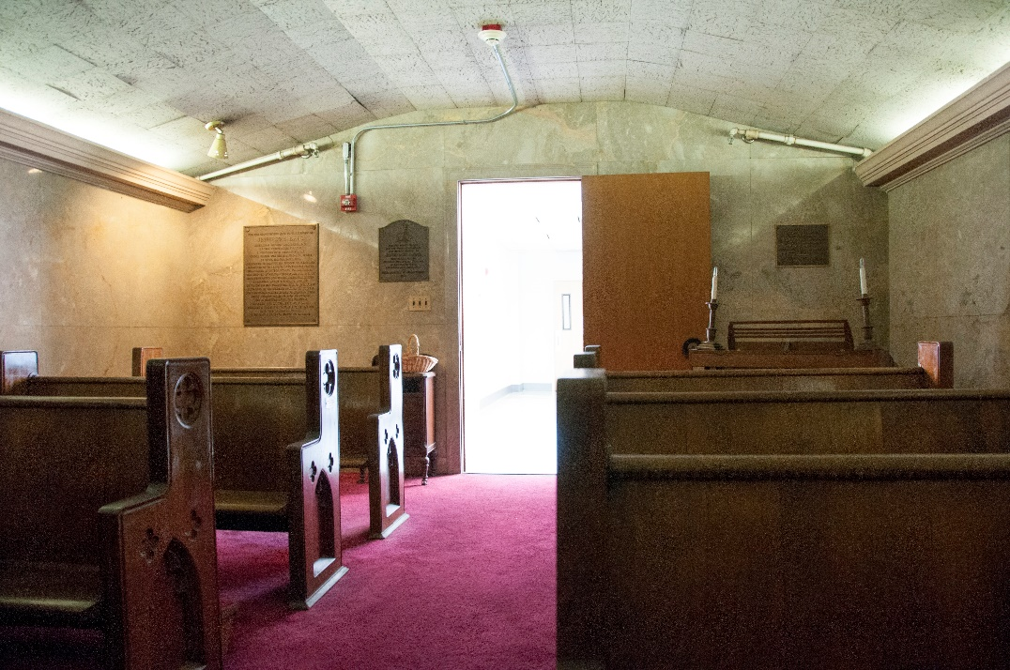
At the back of the chapel are plaques honoring Davis and the then-president of the United Daughters of the Confederacy

Slide 25
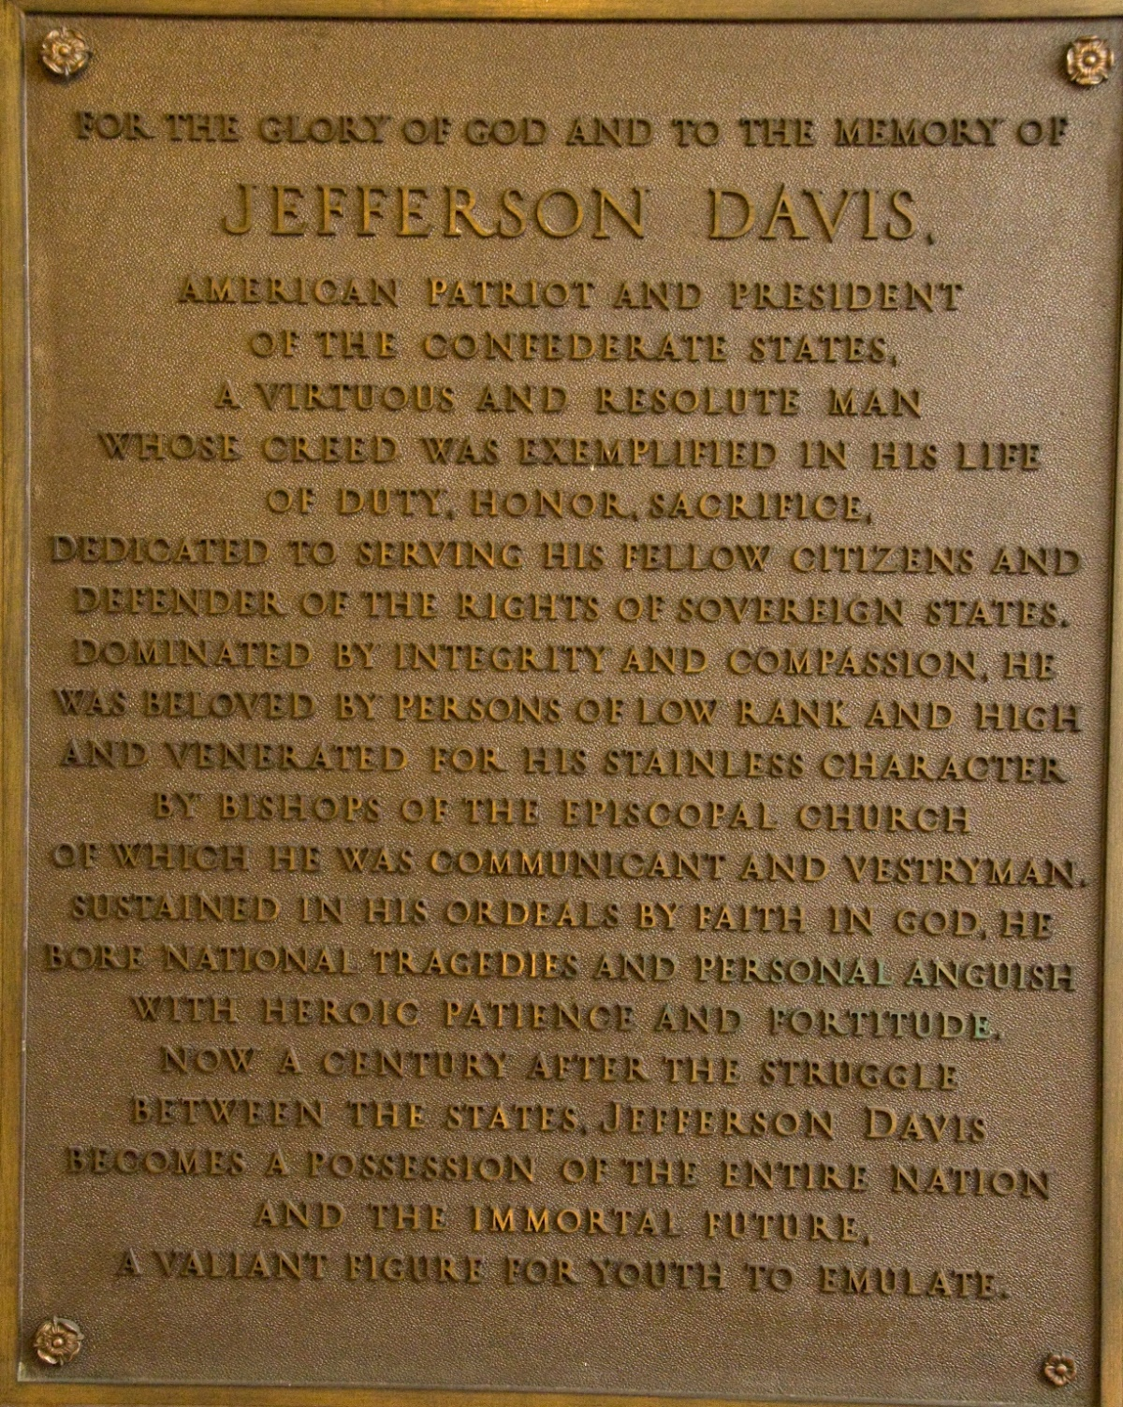
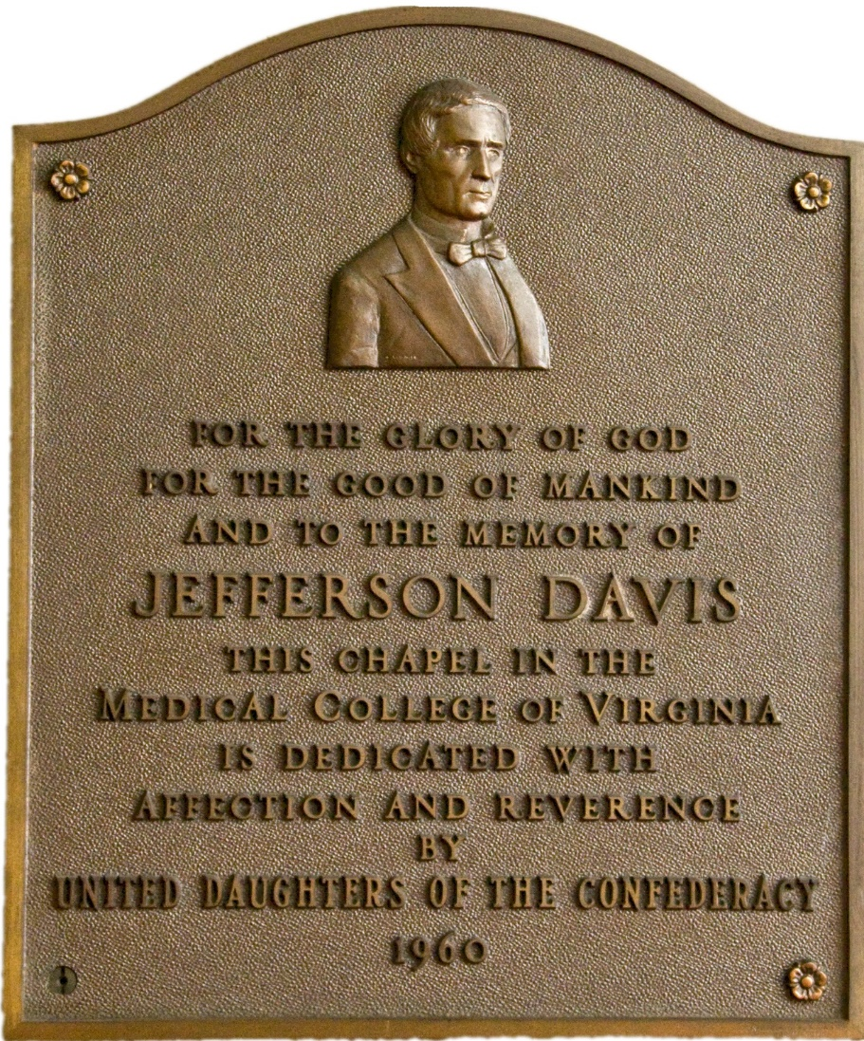
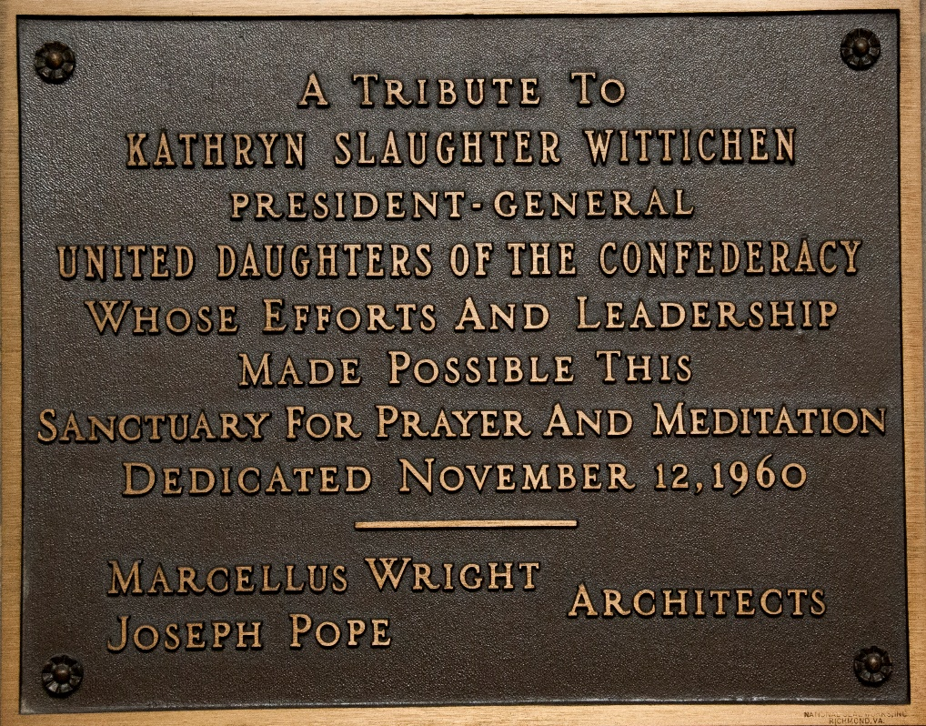
Plaques in the Jefferson Davis Memorial Chapel.

Slide 26
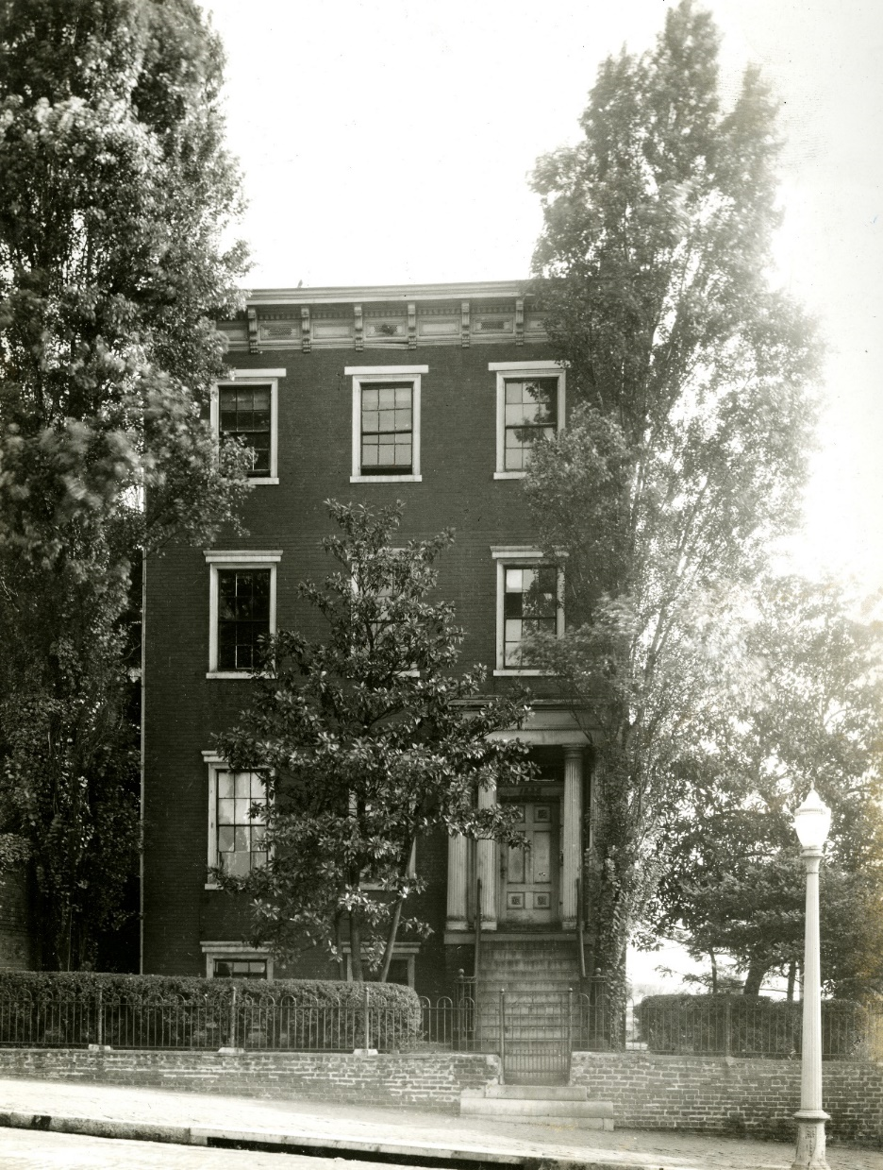
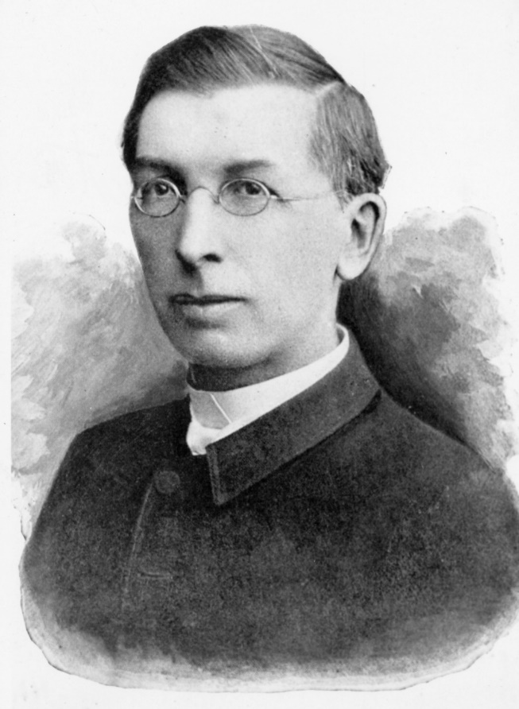
The Beers House was the residence of Rev./Dr. John Brockenbrough Newton, MCV Class of 1860, while serving as rector of Monumental Church located next door. Newton served as a Confederate surgeon and the first president of the MCV Alumni Association.

Slide 27
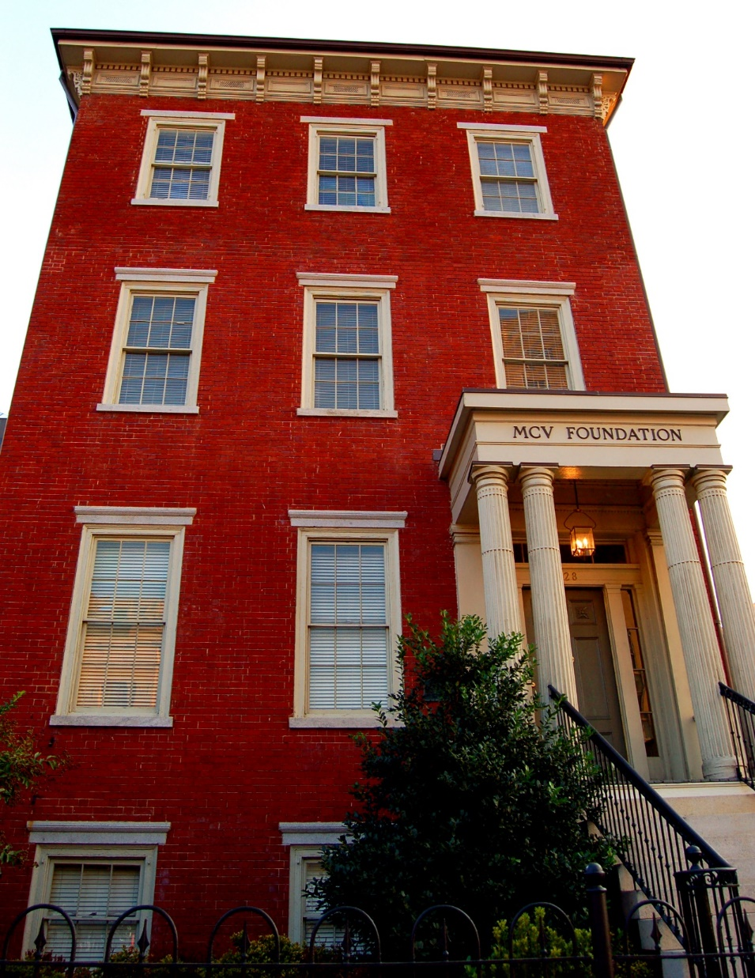
At VCU the house is known as the Beers-Newton house to recognize the original builder and first alumni association president. The building serves as the home of the MCV Foundation.

Slide 28
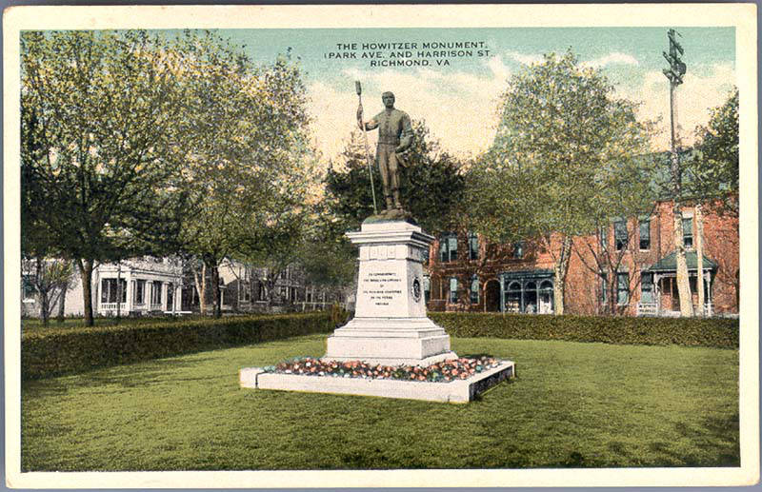
In 1892, the Richmond Howitzer Association erected a monument dedicated to the Richmond Howitzers Artillery Battalion. Artist and former Howitzer member William Ludwell Sheppard created the statue of the artillery man in collaboration with sculptor Caspar Buberl.

Slide 29
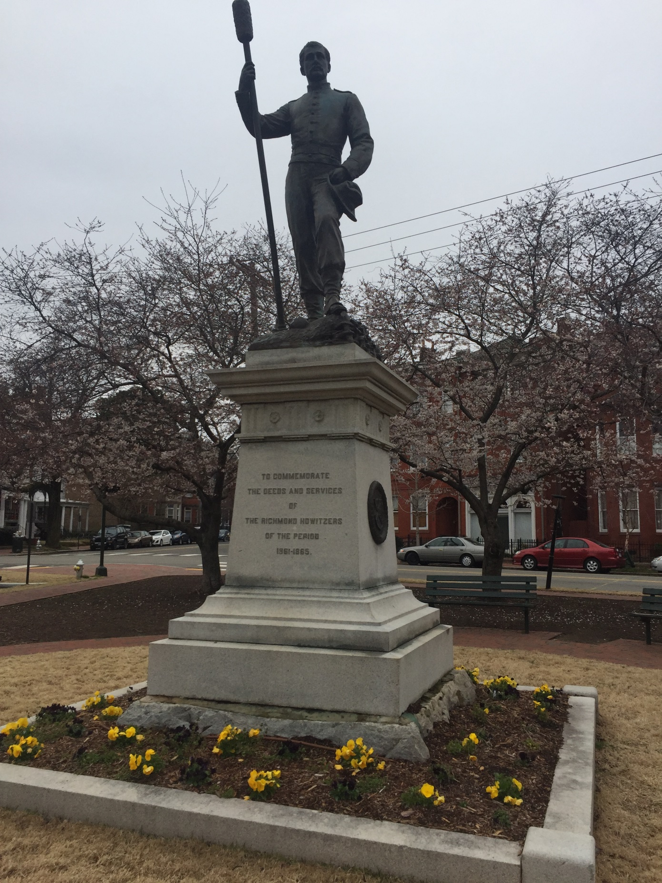
VCU acquired the “Howitzer Park” property at Grove and Park Avenues and Harrison Street from the City of Richmond in July of 1989

Slide 30
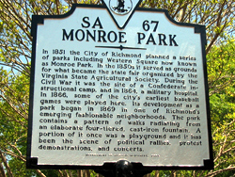
Although VCU does not own Monroe Park, it is often associated with the university because of its close proximity to the Monroe Park Campus. The area was used by the Confederate Army as a military, camp, hospital, and training grounds.

Slide 31
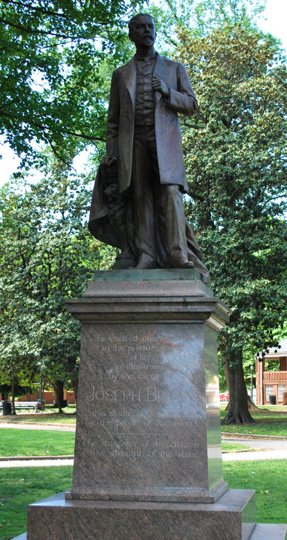
In Monroe Park there is a statue of Joseph Bryan, the Richmond newspaper publisher and philanthropist. During the Civil War, he initially served with the Richmond Howitzers and then with Confederate Colonel John Mosby’s cavalry brigade.

Slide 32
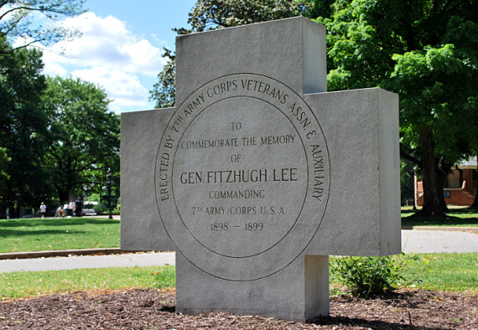
The 7th Army Corps Veterans Association and Auxiliary placed a memorial marker in Monroe Park in 1911 for General Fitzhugh Lee, a Civil War veteran and the nephew of Robert E. Lee. He served in the Spanish- American war and as the 40th governor of Virginia.

Slide 33
The employees of the Chesapeake and Ohio Railroad erected a statue of Williams Carter Wickham in 1911.

Slide 34
Wickham served as a Confederate general, state senator, and vice-president of the Chesapeake and Ohio Railroad.

Slide 35
Confederate Commemoration at VCU
Baruch Auditorium/Egyptian Building
McGuire Hall
Tompkins-McCaw Library
MCV Alumni House
Beers-Newton House
Jefferson Davis Memorial Chapel
Howitzer Statue
Monroe Park Statues and Memorials

